Slide 1
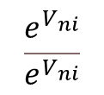
Derivation of the Binary Logit Model
Note: n denotes individual and i and j are alternatives (i.e., two choices)
Using Property 5
Recall Property 5: The difference of two independent Gumbel RVs with the same scale (and variance) follows a logistic distribution.
Multiple
Binary Logit Model
1

Slide 2
Derivation of the Multinomial Logit Model
Recall the setup of the multinomial logit model
P_{n} (k/A_{n}) = probability that an individual ‘n’ will choose alternative ‘k’ from the choice set A_{n} = {1, 2, ... , k, ... M}
Self-practice problem: Derive the multinomial logit model as follows:
2

Slide 3
Method 1

Slide 4
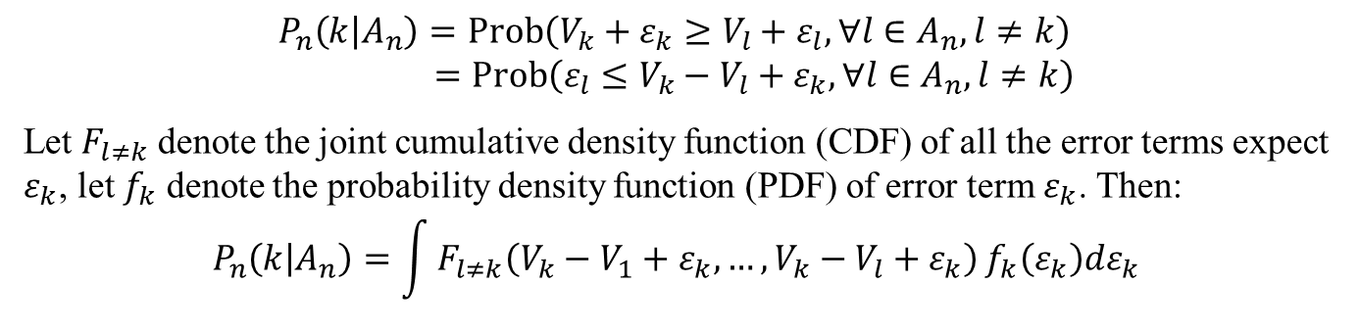
Derivation of the Multinomial Logit Model
P_{n} (k/A_{n}) = probability that an individual ‘n’ will choose alternative ‘k’ from the choice set A_{n} = {1, 2, ... , k, ... M}
$$P_{n}\left(k | A_{n}\right)=Prob\left(V_{k}+ε_{k}≥V_{l}+ε_{l},∀l∈A_{n},l≠k\right) \\ =Prob\left(ε_{l}≤V_{k}−V_{l}+ε_{k},∀l∈A_{n},l≠k\right)$$
Let $F_{l≠k}$ denote the joint cumulative density function (CDF) of all the error terms expect $ε_{k}$, let $f_{k}$ denote the probability density function (PDF) of error term $ε_{k}$. Then: $$P_{n}\left(k | A_{n}\right)=\int{F_{l≠k}\left(V_{k}−V_{1}+ε_{k},…,V_{k}−V_{l}+ε_{k}\right)}f_{k}\left(ε_{k}\right)dε_{k}$$
4

Slide 5
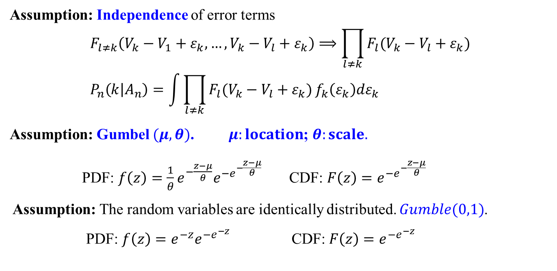
Derivation of the Multinomial Logit Model
Assumption: Independence of error terms
$$F_{l≠k}\left(V_{k}−V_{1}+ε_{k},…,V_{k}−V_{l}+ε_{k}\right)⟹\prod_{l≠k}{F_{l}(V_{k}−V_{l}+ε_{k})} \\ P_{n}\left(k | A_{n}\right)=\int{\prod_{l≠k}{F_{l}(V_{k}−V_{l}+ε_{k})}}f_{k}\left(ε_{k}\right)dε_{k}$$
Assumption: Gumbel $(μ,θ)$. $μ:location$; $θ:scale.$
PDF: $f\left(z\right)={\frac{1}{θ}e}^{−\frac{z−μ}{θ}}e^{−e^{−\frac{z−μ}{θ}}}$ CDF: $F\left(z\right)=e^{−e^{−\frac{z−μ}{θ}}}$
Assumption: The random variables are identically distributed. $Gumble(0,1)$.
PDF: $f\left(z\right)=e^{−z}e^{−e^{−z}}$ CDF: $F\left(z\right)=e^{−e^{−z}}$
5

Slide 6
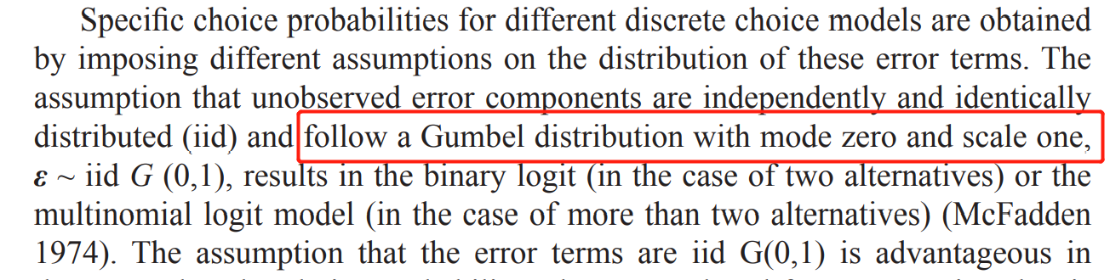
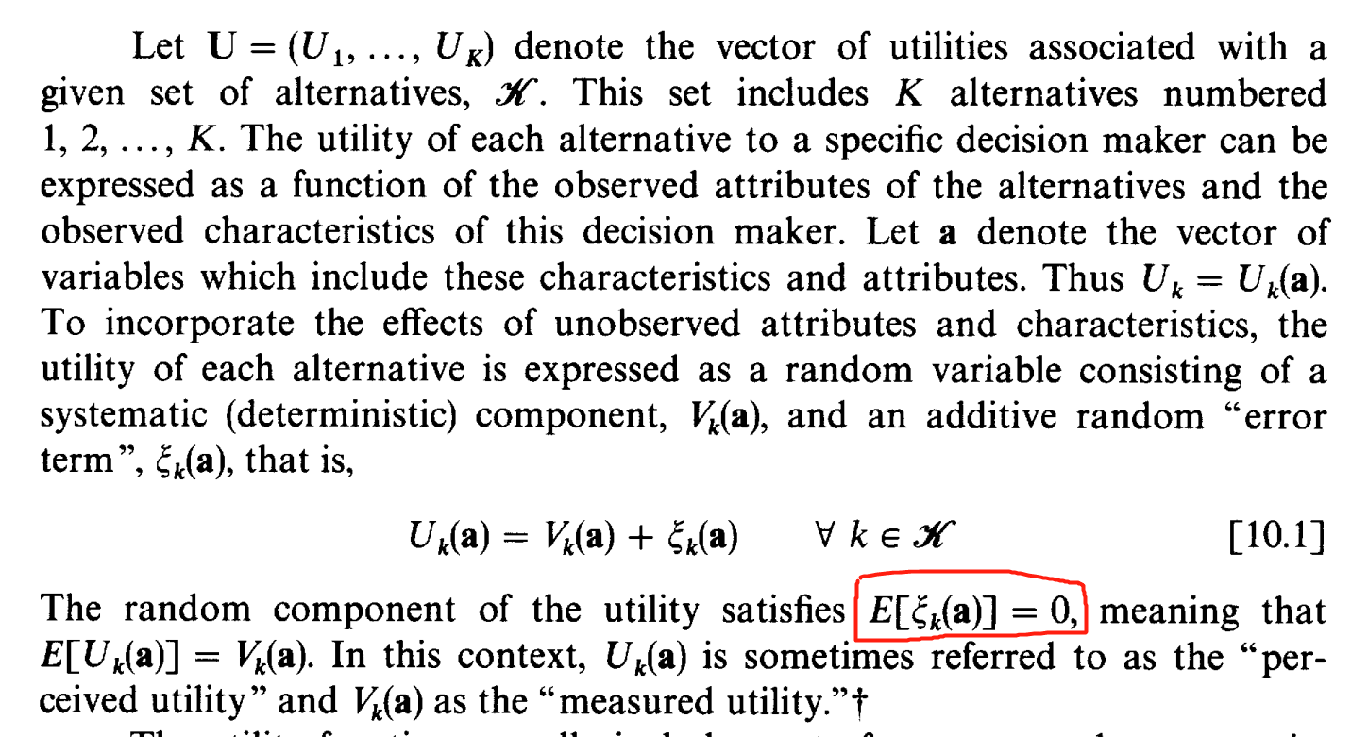
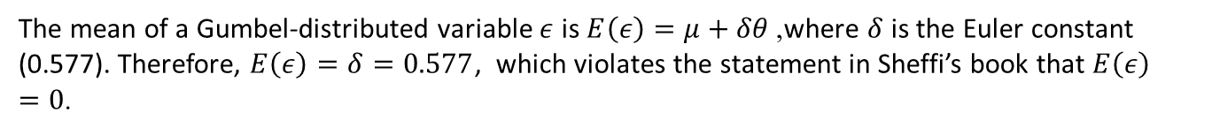
Question:
Discrete Choice Modeling and Air Travel Demand (2010)’s description:
The mean of a Gumbel-distributed variable $ε$ is $E\left(ε\right)=μ+δθ$, where $δ$ is the Euler constant (0.577). Therefore, $E\left(ε\right)=δ=0.577$, which violates the statement in Sheffi’s book that $E\left(ε\right)=0$.
6

Slide 7

Derivation of the Multinomial Logit Model
Then:
$$P_{n}\left(k | A_{n}\right)=\int{\prod_{l≠k}{F_{l}(V_{k}−V_{l}+ε_{k})}}f_{k}\left(ε_{k}\right)dε_{k} \\ =\int{\prod_{l≠k}{e^{−e^{−(V_{k}−V_{l}+t)}}}}e^{−t}e^{−e^{−t}}dt \\ =−\int{\prod_{l≠k}{e^{−e^{−\left(V_{k}−V_{l}\right)}∙e^{−t}}}}e^{−e^{−t}}de^{−t} \\ =−\int{e^{\sum_{l≠k}{\left(−e^{−\left(V_{k}−V_{l}\right)}∙e^{−t}\right)}}}e^{−e^{−t}}de^{−t} \\ =−\int{e^{−e^{−t}+\sum_{l≠k}{\left(−e^{−\left(V_{k}−V_{l}\right)}∙e^{−t}\right)}}}de^{−t}$$
For simplicity, let $x=e^{−t}$:
$$P_{n}\left(k | A_{n}\right)=−\int{e^{−x+\sum_{l≠k}{\left(−e^{−\left(V_{k}−V_{l}\right)}∙x\right)}}}dx$$
7

Slide 8
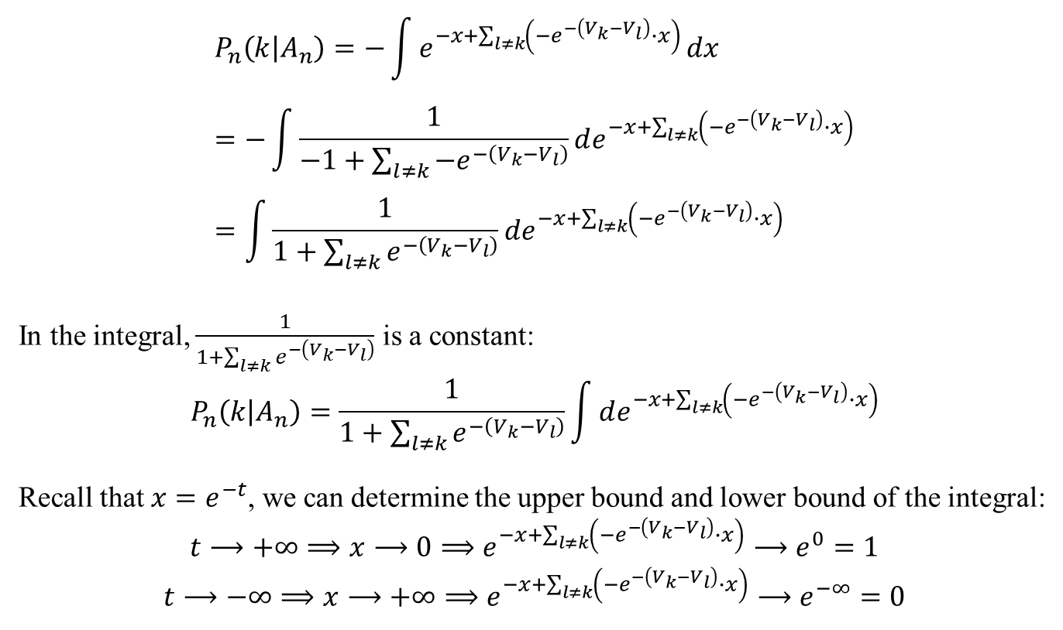
Derivation of the Multinomial Logit Model
$$P_{n}\left(k | A_{n}\right)=−\int{e^{−x+\sum_{l≠k}{\left(−e^{−\left(V_{k}−V_{l}\right)}∙x\right)}}}dx \\ =−\int{\frac{1}{−1+\sum_{l≠k}{−e^{−\left(V_{k}−V_{l}\right)}}}}de^{−x+\sum_{l≠k}{\left(−e^{−\left(V_{k}−V_{l}\right)}∙x\right)}} \\ =\int{\frac{1}{1+\sum_{l≠k}{e^{−\left(V_{k}−V_{l}\right)}}}}de^{−x+\sum_{l≠k}{\left(−e^{−\left(V_{k}−V_{l}\right)}∙x\right)}}$$
In the integral, $\frac{1}{1+\sum_{l≠k}{e^{−\left(V_{k}−V_{l}\right)}}}$ is a constant:
$$P_{n}\left(k | A_{n}\right)=\frac{1}{1+\sum_{l≠k}{e^{−\left(V_{k}−V_{l}\right)}}}\int{de^{−x+\sum_{l≠k}{\left(−e^{−\left(V_{k}−V_{l}\right)}∙x\right)}}}$$
Recall that $x=e^{−t}$, we can determine the upper bound and lower bound of the integral:
$$t⟶+∞⟹x⟶0⟹e^{−x+\sum_{l≠k}{\left(−e^{−\left(V_{k}−V_{l}\right)}∙x\right)}}⟶e^{0}=1$$
$$t⟶−∞⟹x⟶+∞⟹e^{−x+\sum_{l≠k}{\left(−e^{−\left(V_{k}−V_{l}\right)}∙x\right)}}⟶e^{−∞}=0$$
8

Slide 9
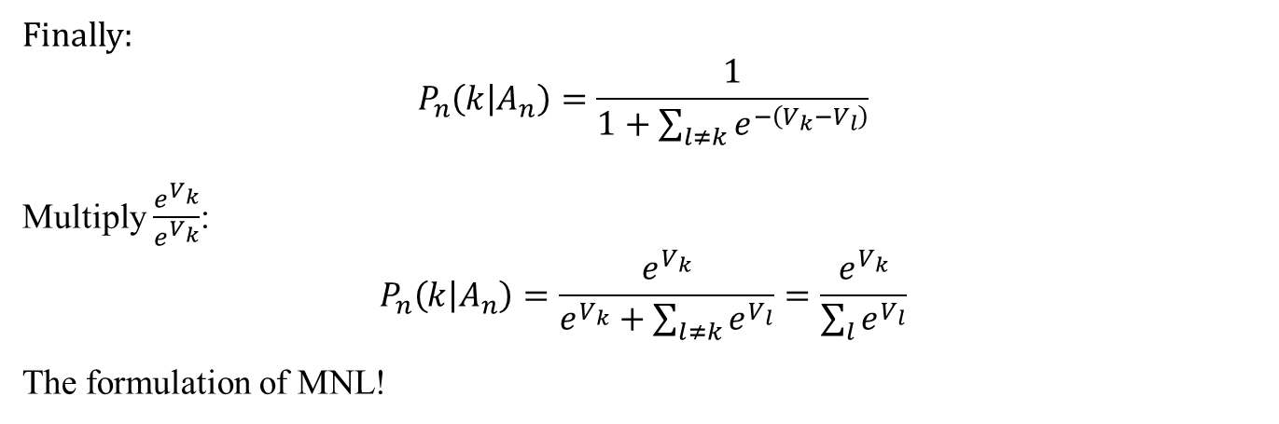
Derivation of the Multinomial Logit Model
Finally:
$$P_{n}\left(k | A_{n}\right)=\frac{1}{1+\sum_{l≠k}{e^{−\left(V_{k}−V_{l}\right)}}}$$
Multiply $\frac{e^{V_{k}}}{e^{V_{k}}}$:
$$P_{n}\left(k | A_{n}\right)=\frac{e^{V_{k}}}{e^{V_{k}}+\sum_{l≠k}{e^{V_{l}}}}=\frac{e^{V_{k}}}{\sum_{l}{e^{V_{l}}}}$$
The formulation of MNL!
9

Slide 10
Method 2

Slide 11

Derivation of the Multinomial Logit Model
P_{n} (k/A_{n}) = probability that an individual ‘n’ will choose alternative ‘k’ from the choice set A_{n} = {1, 2, ... , k, ... M}
$$P_{n}\left(k | A_{n}\right)=Prob\left(V_{k}+ε_{k}≥V_{l}+ε_{l},∀l∈A_{n},l≠k\right) \\ =Prob\left(ε_{l}≤V_{k}−V_{l}+ε_{k},∀l∈A_{n},l≠k\right) \\ =Prob\left(ε_{l}≤V_{k}−V_{l}+ε_{k},∀l∈A_{n},l≠k\right)$$
11

